Slide 1
AptioV Overview
邱宏伟
2020/07

Slide 2
Aptio V 基础
SEC
PEI
DXE
BDS

Slide 3
Aptio V types of files
Type | Usage
Veb | Project description as a list of CIF file references with Source location
Cif | An Aptio Project Component description file New Section “[INF]” added to list distinct project build units described by the INF files
Sdl | Describes component configuration and build options
Fdf | Describe the content and layout of binary images

Slide 4
Aptio V types of files
Type | Usage
Dsc | Platform Description file
Dec | Define specific information that will be shared between different EDK II Modules
Inf | EDK II build information (INF) file
Mak | Aptio V uses the GNU Make utility for processing makefiles.
C, H, ASM, ASL… | Source files

Slide 5

Basic Concepts in EDKII
Platform
FDF
DSC
Package
Package
Package
Package
Package
DEC
DEC
DEC
DEC
DEC
Module
Module
Module
Module
Module
INF
INF
INF
INF
INF
Module
Module
Module
Module
Module
INF
INF
INF
INF
INF
Module
Module
Module
Module
Module
INF
INF
INF
INF
INF

Slide 6
Basic Concepts in EDKII
FDF:
It is Flash Definition File. The FDF file is used to describe the content and layout of binary images.
DSC:
It is Platform Description file. The EDK II DSC file is used in conjunction with EDK II Flash Description files (FDF), EDK II DEC, EDK II module INF and EDK component INF files to generate binary PE32/PE32+/Coff files.

Slide 7
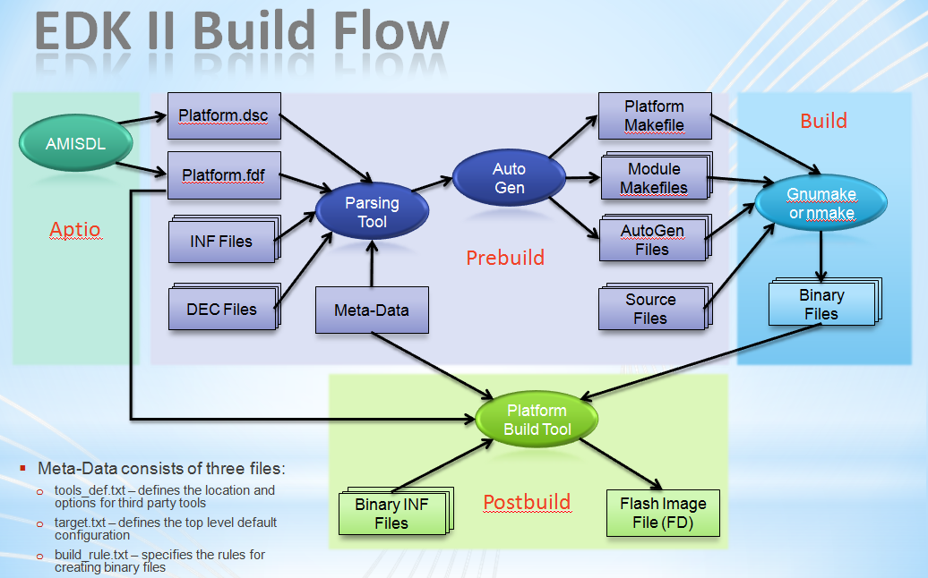
Basic Concepts in EDKII

Slide 8
SEC Phase
Why does SEC Phase need?
Something need Assembly
C can’t handle CPU’s special register
MTRR, CRx……
C needs Memory(R/W) for variable buffer
C needs memory(R/W) for stack
Let CPU go to Protected Mode(Flat Mode)

Slide 9
SEC Phase
Switch to C code
Enter Protected Mode(Flat Mode)
Linear address mode
Stack for C code
Transfer to PEI Phase

Slide 10
Pre-EFI Initialization(PEI)
Why PEI Phase?
Code is not compressed
Memory is not initialized
Chipset is not initialized
Points of PEI Phase
Code is executed on ROM
Code is not compressed
PEI Core code is not related to platform

Slide 11
PEI – Do what?
Basic initialization for Chipset
Memory Sizing
BIOS Recovery
ACPI S3 Resume
Switch Stack to Memory
Disable CAR
Enable Cache
Invoke DxeIpl (DXE Initial Program Loader)

Slide 12
PEI – CORE, SERVICE, PEIM, PPI
PEI Core
Provide service for PEIM
Load and Execute PEIM
PEI Service
PEI Core service routine , all PEIMs can use them
PEIM
PEI Module
PPI
PEI to PEI Interface，PEIM provides interface to others

Slide 13
PEI – Flow Chart
Initialize PEI Core
Execute PEIM based on dependency status
Different Boot Mode are likely using different boot path
Execute DXE IPLPEI
PEI Start
PEI Core dispatch
initialization
PEIM n
PEIM 3
Pass 1 EntryPoint
PEIM 2
Pass 1 EntryPoint
Dispatch PEIM in
PEIM 1
Pass 1 EntryPoint
an orderly manner
Pass 2 EntryPoint
Entry Point
Pass 2 EntryPoint
Pass 2 EntryPoint
DXE IPL PEIM
PEI Core
Entry Point
dispatches DXE
IPL
DXEIPL PPI
Load/Start DXE

Slide 14
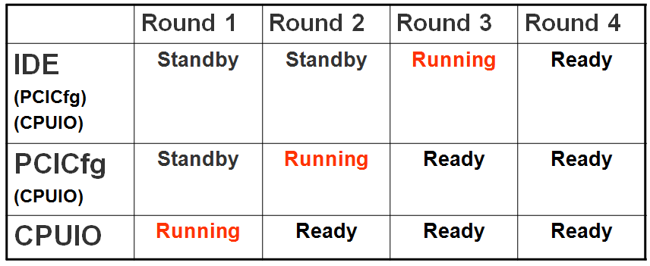
PEI - Dependency
PEIMs Order
Dependency for PEIM priority
Without Dependency, the order is in ROM image

Slide 15
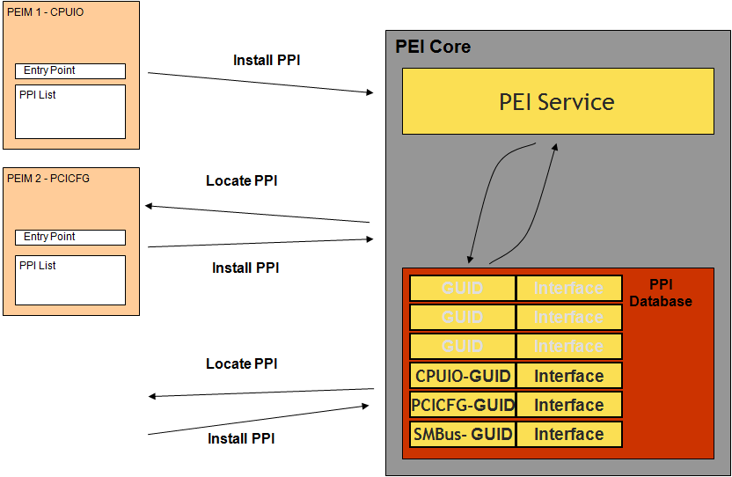
PEIM & PPI Working Model

Slide 16
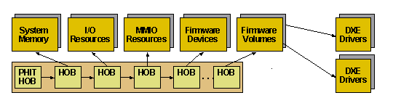
PEI – HOB
HOB : Hand off Block
Why?
PEI Phase pass some information to DXE Phase
Data Structure
Every Block has its own GUID & Structure

Slide 17
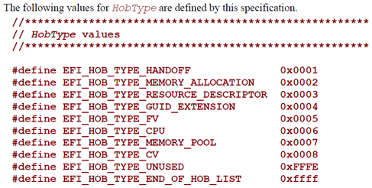
PEI – HOB
Operational Module
When PEI Module needs to pass information to DXE phase, It will call PEI Service to create a block of HOB in HOBList
Type
Hand Off (PHIT)
Memory Allocation
Resource Descriptor
GUID extension
FV
CPU
Memory Pool
CV (Capsule Volume)
Unused

Slide 18
PEI – Summary
PEI Phase the shorter the better
Goal
Essential Initialize for Hardware
Memory Sizing
S3 Resume
Recovery
DXEIPL the last invoked PEI Module
DXEIPL pass information to DXE by HOB List

Slide 19
DXE – Why?
DXE Phase Drivers build the interface for EFI Framework
Easy to integrate 3rd party code
Initialize Code
Runtime Code
VGA, Network Onboard Driver
Modular SMM

Slide 20
DXE – Do what?
Run all DXE Drivers, Make them Ready
Bind EFI Driver
Invoke BDS

Slide 21
DXE Feature
All Drivers are compressed
Code is running on RAM
CPU Cache Enabled
All Memory Resource are accessible
DXE core is not related to platform
*Avoid using Interrupt
*Single Thread

Slide 22
DXE Handle & Protocol
DXE Driver is operating by Handle & Protocol
Handle
Distinguish entity
Software
File Image
Abstract Device (ex.New handle after Partition)
Service Driver (ex.Compress)
Hardware
Controller (PCI, SATA, IDE)
Bus (PCI, IDE)
Device (Audio, Video, HDD, Keyboard)
Handle represents entity
Handle function by Protocol
Driver can create one or more Handles

Slide 23
DXE Handle & Protocol
Protocol
Driver produce Protocol
Handle contains Protocol not only Functions but also Private Data
Private Data come from Bus Driver will affect child Handle’s Protocol
By combination of Protocol & Private Data, we can create different entity
Different Handle can apply same protocol

Slide 24
Handles Protocol Database

Slide 25
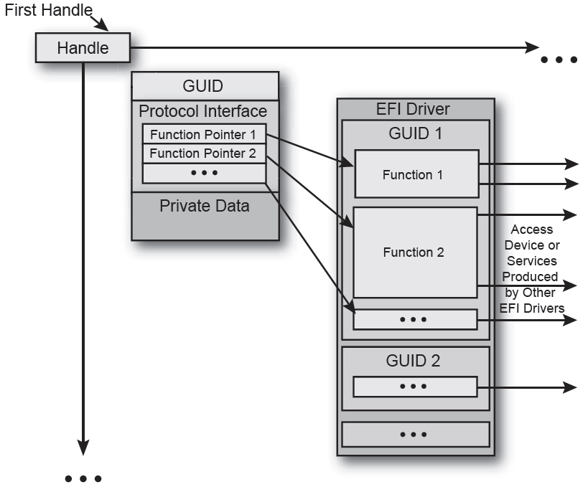
Protocol

Slide 26
DXE Driver Architecture
What does DXE Core provide?
System Table
Basic Input, Output
RunTime Service
Boot Service
ConfigurationTable
ImageHandle
Driver get it when DXE Core allocate Memory for him
EFI_LOADED_IMAGE_PROTOCOL
Every Driver can get same service from Core

Slide 27
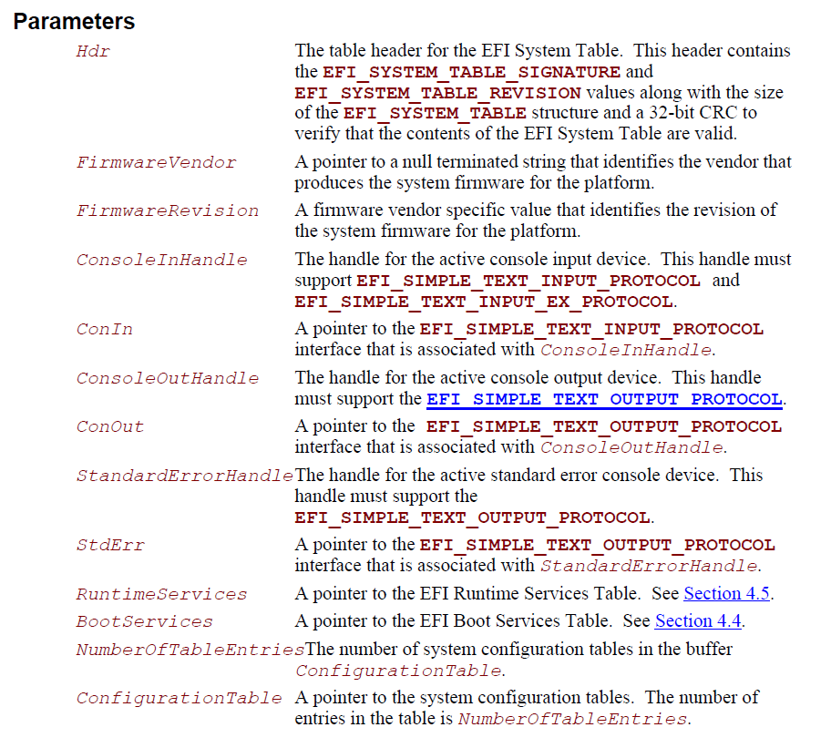
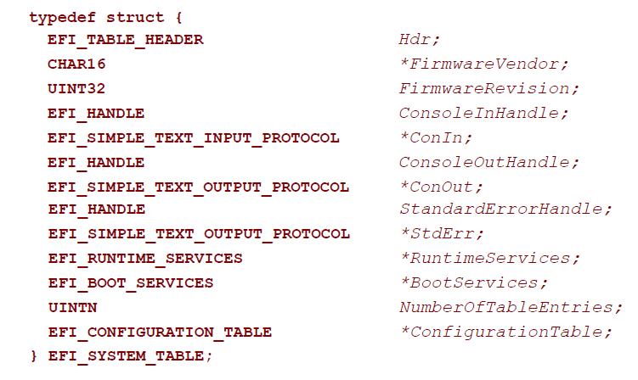
EFI System Table
The primary data structure with data information tables and function calls to interface with the systems

Slide 28
DXE - Summary
In EFI spec., All necessary API for Framework will be produced in DXE phase
Generally speaking, DXE Driver is not for Chipset initialization
EFI Driver is just loaded into memory, it will be Connected to Device Handle during BDS phase

Slide 29
Why need BDS phase
Provide an interface to interact with OS
Provide an interface to set hardware status.
Points of BDS phase
A part of DXE Code
Boot device select by user.

Slide 30
What does BDS phase do
Binding essential drivers
PCI Enumeration
Connect consoles(PS/2,VGA,USB KBD)
Boot device initialization(IDE/SATA/SCSI)
Goto SETUP
Boot Manager
Device Setting
System Information
Selecte device boot to OS
Boot Legacy OS
Boot EFI-aware OS

Slide 31
BDS HiiDatabase, VFR & UNI
Setup
HiiDatabase
The Database store string/font/form
– String (String Token/.uni)
Unicode, can show different language in one screen
Support multi-language by string token
– Font
Store with bitmap, index by unicode
Only used font will be added in
– Form (Form/.vfr/.ifr)
Used to describe the relation between item and options
VFR is text file, easy to modify
IFR is the binary generated from compile VFR

Slide 32
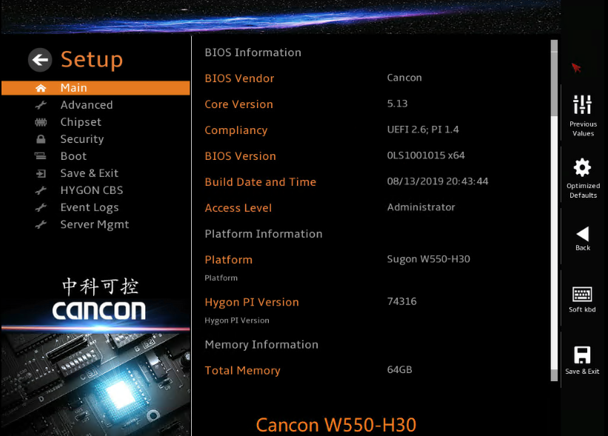
Setup

